Slide 1
Term 2 Week 3
Numbers + Dates

Slide 3
Learning Outcome
By the end of the lesson you should be able to:
Understand the difference between western and Chinese date formats.
express and write “Year”, “month” and ”day” (年，月，日）in Chinese

Slide 4
Western VS. Chinese Date format
In Australia when we write the 29th of April 2020:
29/04/2020
In Chinese we write:
2020年4月29日
Year first, month next, and day last.

Slide 5
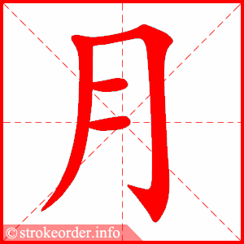
rì
yuè

Slide 6
rì
yuè
sun / day
moon / month

Slide 7
Activity 1: Practice month in Chinese
On a piece of lined paper, write the month in both Chinese & English
一月 | January
二月 | February
三月 | March
四月 | April
五月 | May
六月 | June
七月 | July
八月 | August
九月 | September
十月 | October
十一月 | November
十二月 | December

Slide 8
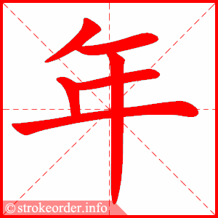
nián
Do you still remember the story about the monster Nian?
What does nián mean?

Slide 9
nián
Do you still remember the story about the monster Nian?
What does nián mean?
year

Slide 10
Year Format
Chinese numbers + 年【nián =year】
Example:
The year of 1992
1992年
一九九二 年
一【yī=one】 九【jiǔ=nine】 九【jiǔ=nine】 二【èr=two】 年【nián =year】
The year of 1836
1836年
一八三六年

Slide 11
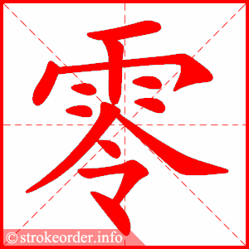
How to write the year of 2020?
líng
In Chinese “0” can be written as 〇 or 零.
The year of 2020 can be written as
二〇二〇年
or 二零二零年
zero

Slide 12
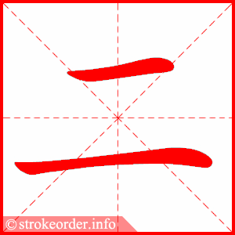
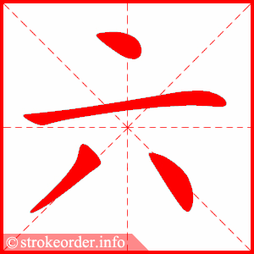
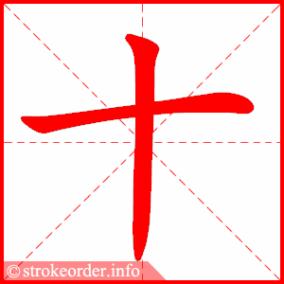
yī èr sān sì wǔ
liù qī bā jiǔ shí

Slide 13
Activity 2: Write the Dates of 2020 Christian Religious Holidays in Chinese
On a piece of lined paper, write holiday names in English and the dates in Chinese
Good Friday
Christmas Eve
Christmas
Ash Wednesday
Easter
Example:
St. Valentine's Day
2020年2月14日
二〇二〇年二月十四日

